Slide 1
Adult Mortality Section CAPI Instructions

Slide 2
Adult mortality : key points
Begin by listing names of siblings
Then ask a series of “probe” questions to ensure no siblings are left out
Then ask respondent to give order in which siblings born
Once list completed, pass to the section 14 grid
Tablet will check ages of siblings listed in order using :
Age of sibling if alive
Number years ago died + age at death if dead
To re-order, go back to beginning and re-enter
This is why it is important to establish correct order in initial listing of names
Notes:
Go through this section in the manual. It is a good idea to ask participants to read different sections before you explain the section.

Slide 3
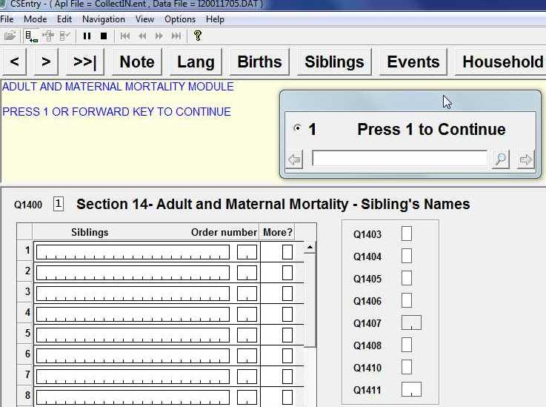
When section appears, begin by entering “1”

Slide 4
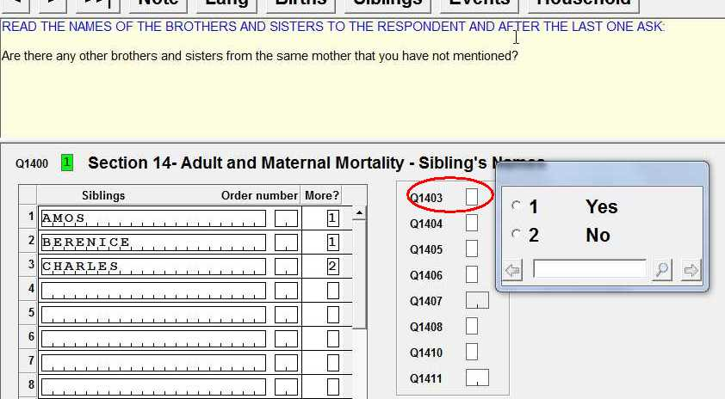
When respondent says there are no more siblings, pass to Q1403 to probe for any more siblings she did not mention

Slide 5
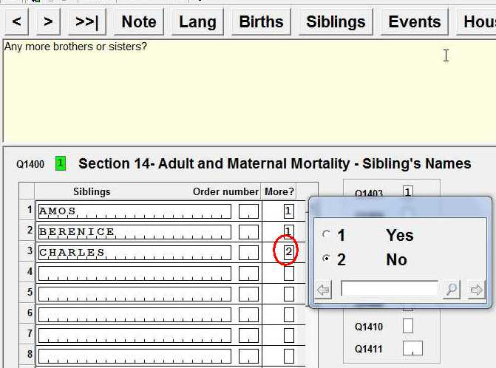
If Q1403 response is “Yes” ..
Program will return to siblings table
Change response for the “More” column to “Yes” to enter the additional siblings that the respondent did not mention previously
When all remaining siblings entered, enter “No” in the “More” column
Program will return to Q1403.
Change the response to “No” to move forward.
Do not repeat Q1403 to the respondent !

Slide 6
Additional probe questions
Number | Question
Q1404 | “Some people forget to mention children born to their natural mother because they do not live with them or they do not see them very often. “
Q1405 | “Sometimes people forget to mention children born to their natural mother because they have died”
Q1406 | “Some people have brothers or sisters from the same mother but a different father”
Use the same approach as you use for Q1403 for remaining probe questions

Slide 7
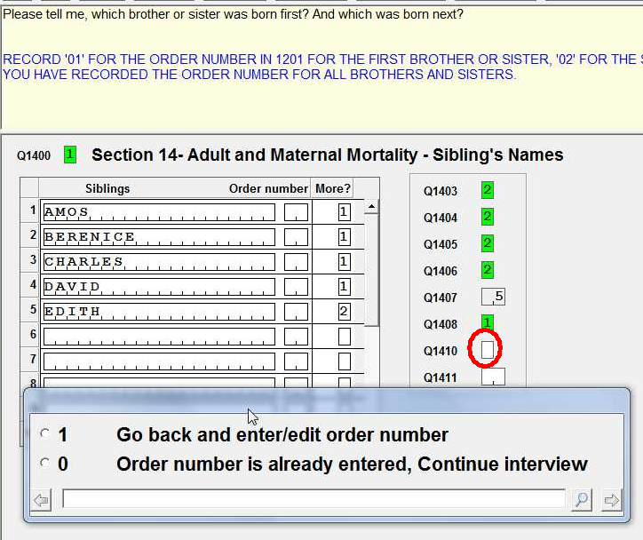
Q1410 is used to begin the series of questions establishing the order of birth of each sibling. When this field is reached for the first time, enter “1” to tell the system to go back into the list of siblings beginning with the first named.

Slide 8
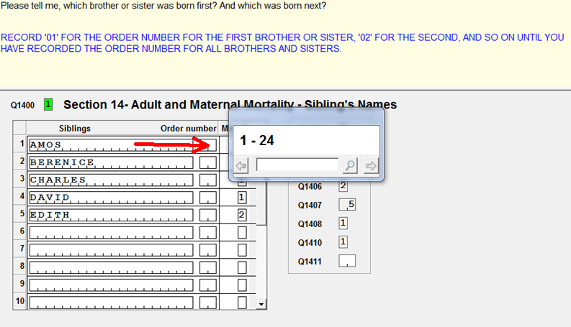
*After entering “1” in Q1410 the cursor will go back to the first name field in the siblings table. Press <Enter> to move the cursor to the “Order Number” column. Then, ask the question about order for each sibling and record the order of births with #1 being the oldest.
* Be careful not to duplicate order numbers !

Slide 9
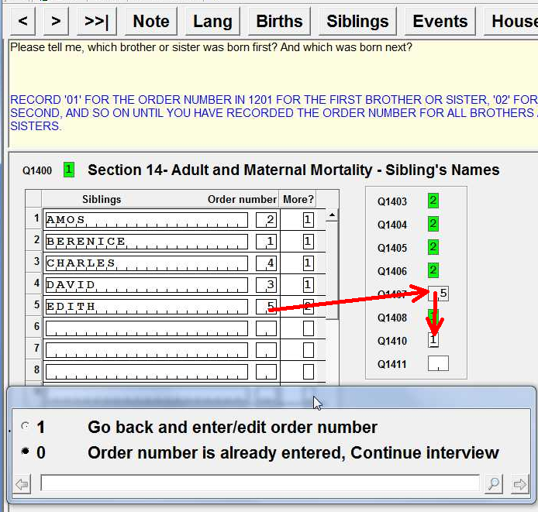
* When you have finished entering the order numbers the tablet will take the cursor back to Q1407.
* DO NOT ASK Q1407 AGAIN !
* Move to Q1410 and change response to “0 : order number is already entered”

Slide 10
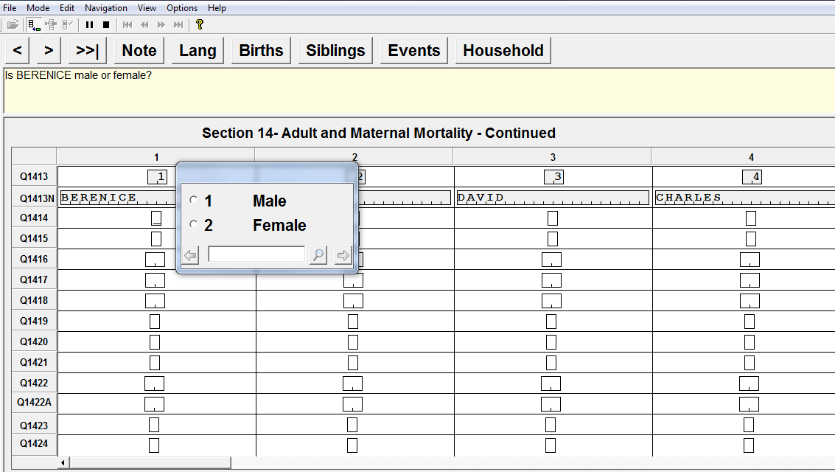
When Q1411 is entered program will pass to record Adult mortality information in a table.
Note order is determined by order entered in previous siblings table

Slide 11
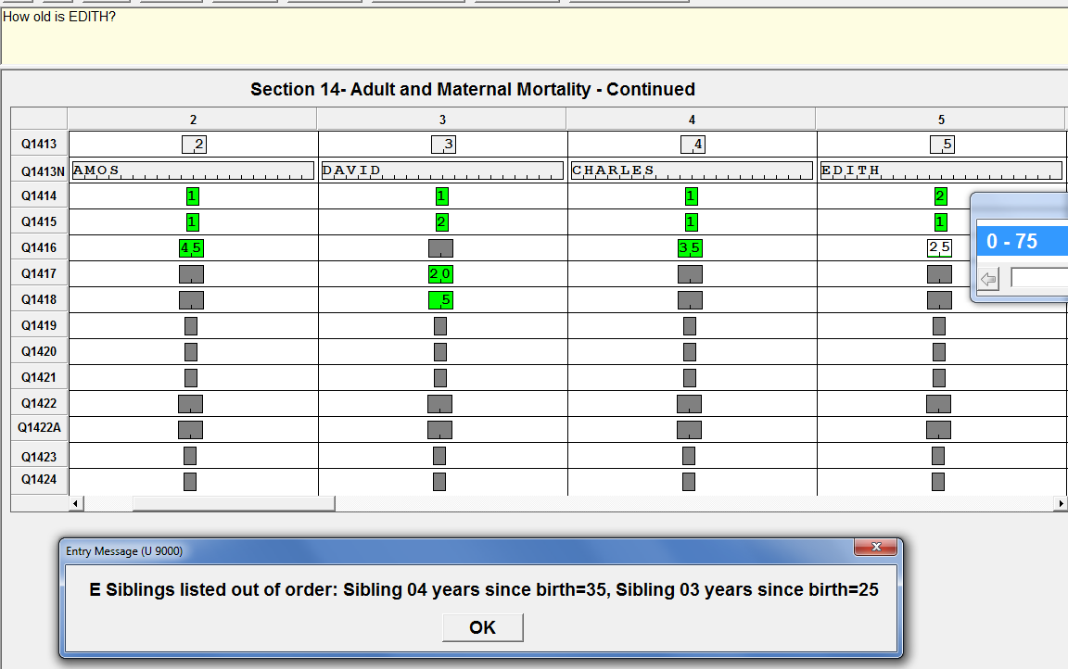
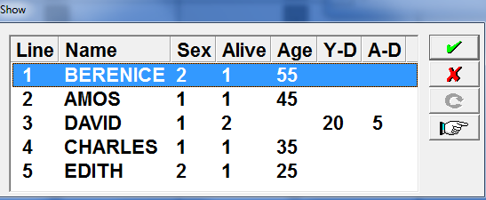
Siblings listed out of order
Error ! David and Charles are listed out of order of date of birth

Slide 12
Resolving order problems in Adult Mortality tables
Line | Name | Sex | Alive | Age | Y-D (years since death) | A-D (age at death) | Years since birth
1 | Berenice | F | Y | 55 |  |  | 55
2 | Amos | M | Y | 45 |  |  | 45
3 | David | M | N |  | 20 | 5 | 25
4 | Charles | M | Y | 35 |  |  | 35
5 | Edith | F | Y | 25 |  |  | 25
Use table shown by tablet after error message to calculate years since birth by using age if alive or Y-D + A-D (years since death+age at death)
Determine whether problem is keying error or if order needs to be changed
Return to sibling table to edit order and re-enter Adult Mortality table

